Slide 1
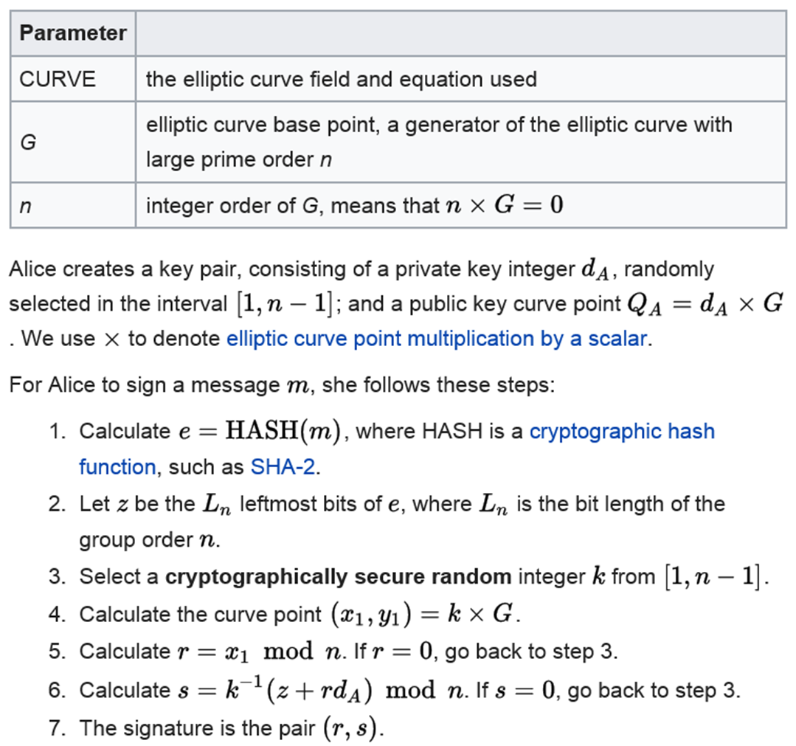
Student ID: ______ Name: ______ d = ___ = 3 + “the last digit of your ID” mod 4, 3 ≤ d ≤ 6
On the curve E : y² = x³ + 2x + 2 mod 17 with the base point G = (5, 1) and n = 19,
sign the message hash z = 10 with k = 5, kG = (9, 16) and your private key d.
The signature pair is (r, s) = _____

